Slide 1
Some Python Basics
Mon Sept 13

Slide 2

Running Python from JuPyTeR
You’ve downloaded JuPyTer
The ‘Py’ in JuPyTer stands for Python
Click on JuPyTeR icon to start the program
The JuPyTer web icon looks like this:

Slide 3
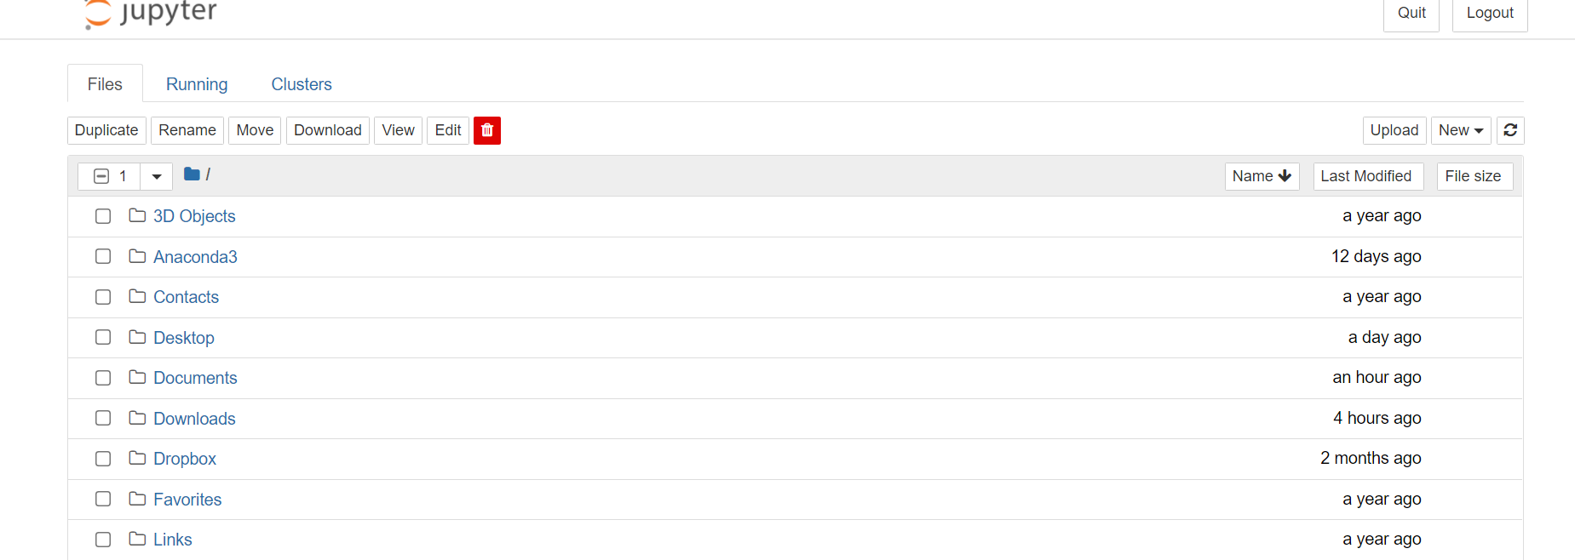
After a few other screens gets you to this

Slide 4
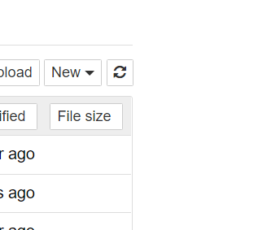
Now you need to start a Python Session
Click on the “New” button in the upper right of the screen as shown here:

Slide 5
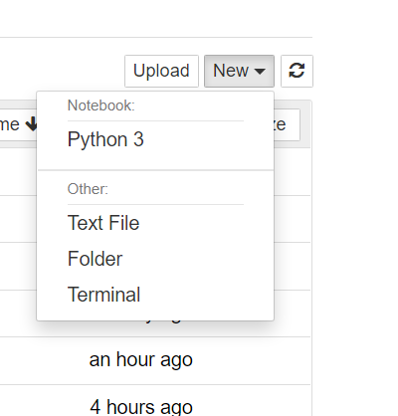
Clicking on “New”
When you click on “New” it will a menu shows up which includes Python 3
Go to the Python 3

Slide 6
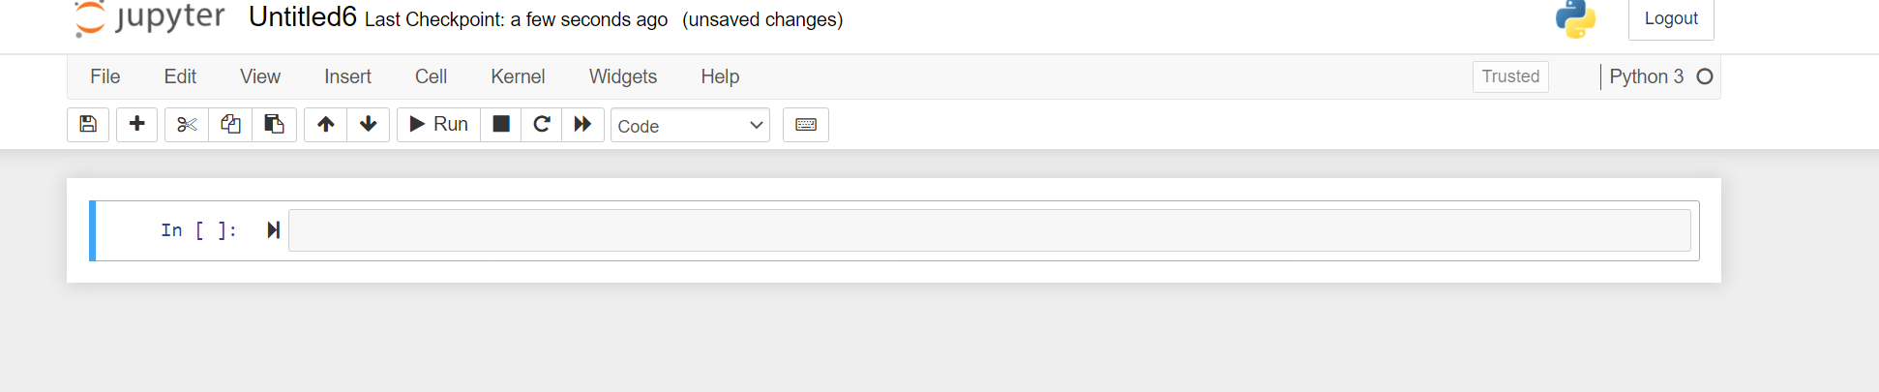
This gets you to a Python Screen

Slide 7
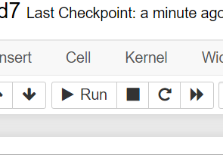
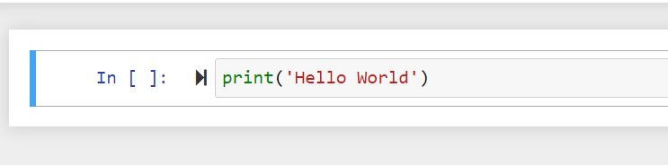
Simplest Program: Enter then hit the “Run” key

Slide 8
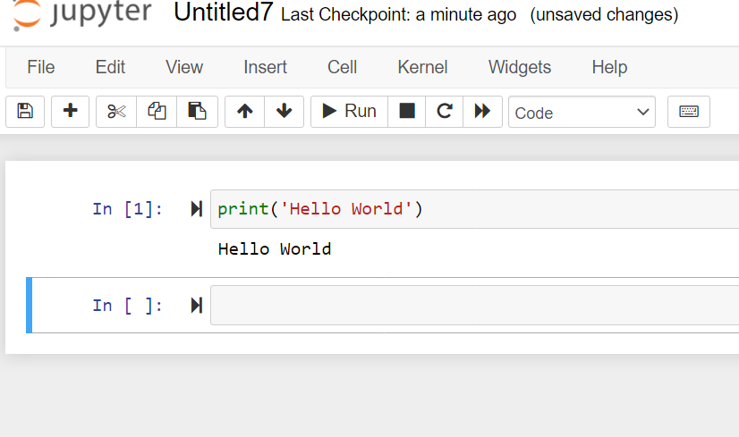
Program runs; then we save it
Then go to File
Save as
HW
It will be saved as the HW notebook

Slide 9
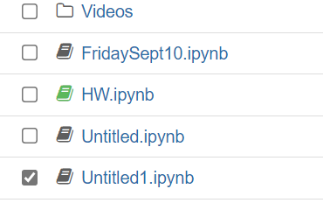
Go back to the Home Page JuPyTeR page
It shows up as HW.ipynb

Slide 10
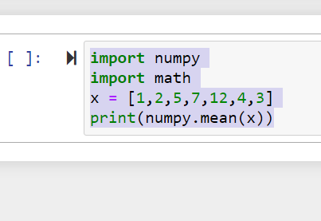
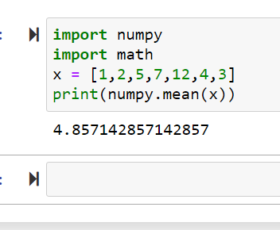
More interesting program; Run to get:

Slide 11
Python Libraries
What is this doing?
Import Libraries
‘Numpy’ is the Python library (written in C or C++) that implements “linear algebra” operations on vectors and matrices
‘Math’ is the Python library that does, well,….

Slide 12
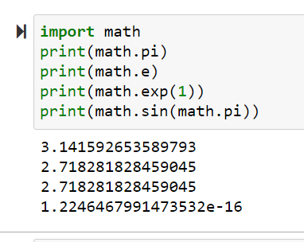
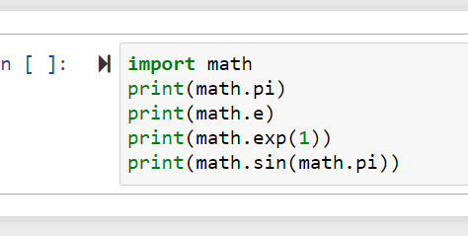
Math in action

Slide 13
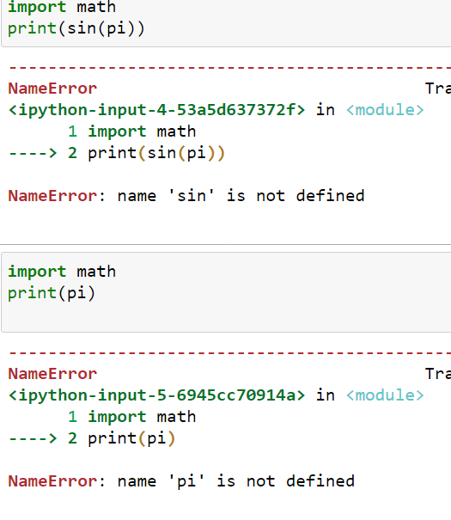
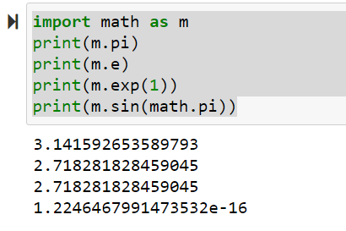
Common error and saving characters

Slide 14
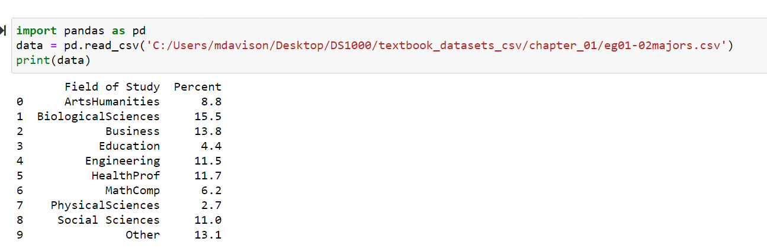
Downloading Data from a flat ‘.csv’ file

Slide 15
Important fact
data = pd.read_csv('C:/Users/mdavison/Desktop/DS1000/textbook_datasets_csv/chapter_01/eg01-02majors.csv')
Only works on my machine. You will have to modify that to show where the same data is stored on your own machine.

Slide 16
What is pandas?
It is a python package that deals with “panel data”
It allows us to upload 3 kinds of data:
1 dimensional (‘Series’) (think stock prices over time( .
2 dimensional (tables; called ‘frames’ here) (think a table of data like the one we just saw, but maybe with > 2 columns)
3 dimensional (‘panels’) think measurements of height and weight for many babies taken over many times).

Slide 17
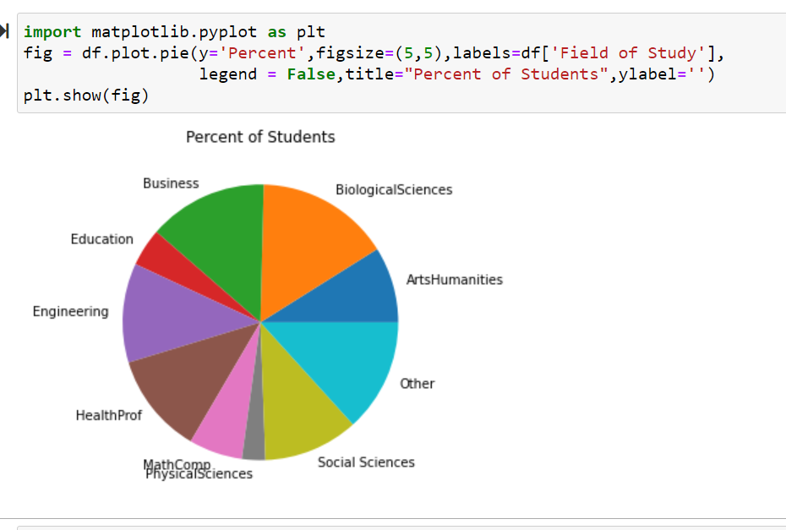
Making Pie Chart (same data as earlier table)

Slide 18
Downloading data from Web
Begin by installing python datareader
Command is pip install pandas_datareader
Now suppose we want to download stock prices from Yahoo Finance (free and you don’t need to register).

Slide 19
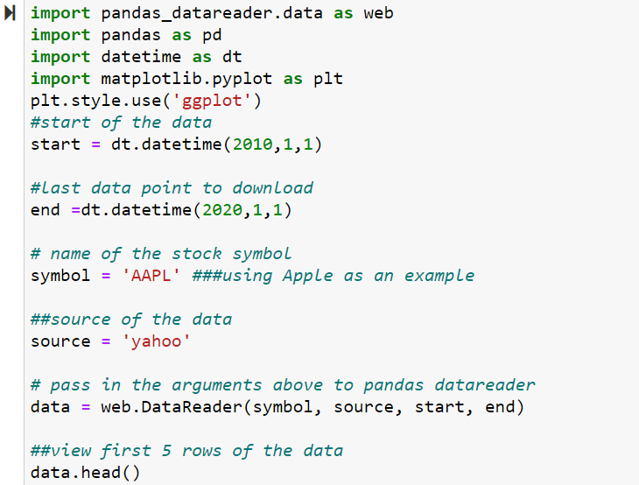
Code to download Apple Stock Prices

Slide 20
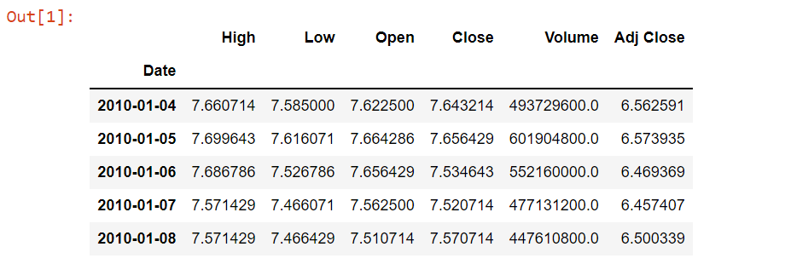
Output

